Slide 1

ECUACIONES DIFERENCIALES
Dr. DANIEL SAENZ CONTRERAS

Slide 2

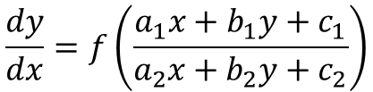
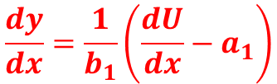


REDUCIBLES A VARIABLES SEPARABLES
Son Ecuaciones Diferenciales De La Forma
Caso en el cual se hace la siguiente sustitución
$$U=a_{1}x+b_{1}y$$
$$\frac{dy}{dx}=f\left(\frac{a_{1}x+b_{1}y+c_{1}}{a_{2}x+b_{2}y+c_{2}}\right)$$
$$\frac{dU}{dx}=a_{1}+b_{1}\frac{dy}{dx}$$
En la cual se cumple
$$a_{2}x+b_{2}y+c_{2}=k(a_{1}x+b_{1}y)+c_{1}$$
$$\frac{dy}{dx}=\frac{1}{b_{1}}\left(\frac{dU}{dx}−a_{1}\right)$$

Slide 3

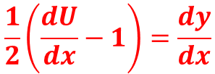




REDUCIBLES A VARIABLES SEPARABLES
Cambio de variable
Solucionar
$$U=x+2y$$
$$\frac{dy}{dx}=\frac{2x+4y+1}{x+2y−1}$$
$$\frac{dU}{dx}=1+2\frac{dy}{dx}$$
Analizando la fracción observamos que en el numerador podemos factorizar el 2
$$\frac{dU}{dx}−1=2\frac{dy}{dx}$$
$$\frac{dy}{dx}=\frac{2(x+2y)+1}{x+2y−1}$$
$$\frac{1}{2}\left(\frac{dU}{dx}−1\right)=\frac{dy}{dx}$$

Slide 4


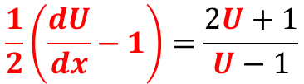



REDUCIBLES A VARIABLES SEPARABLES
Realizando la sustitución
$$\frac{dU}{dx}=\frac{4U+2+U−1}{U−1}$$
$$\frac{1}{2}\left(\frac{dU}{dx}−1\right)=\frac{2U+1}{U−1}$$
$$\frac{dU}{dx}=\frac{5U+1}{U−1}$$
Variables separables
despejando
$$\frac{dU}{dx}−1=\frac{2(2U+1)}{U−1}$$
Separando variables
$$\frac{U−1}{5U+1}dU=dx$$
$$\frac{dU}{dx}=\frac{4U+2}{U−1}+1$$

Slide 5
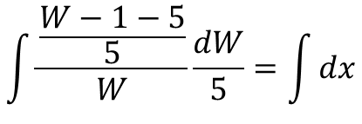

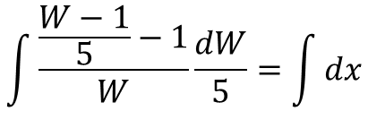
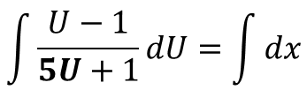



REDUCIBLES A VARIABLES SEPARABLES
Integrando
$$\frac{dU}{dx}=\frac{1}{5}\frac{dW}{dx}$$
$$\int{\frac{U−1}{5U+1}dU}=\int{dx}$$
Realizando la sustitución
Aplicando sustitución
$$\int{\frac{\frac{W−1}{5}−1}{W}\frac{dW}{5}}=\int{dx}$$
$$W=5U+1$$
$$W−1=5U$$
$$\int{\frac{\frac{W−1−5}{5}}{W}\frac{dW}{5}}=\int{dx}$$
$$U=\frac{W−1}{5}$$

Slide 6
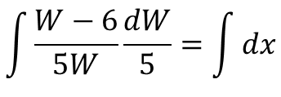
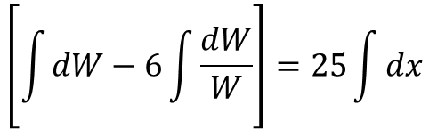
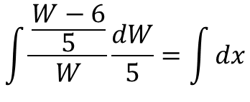
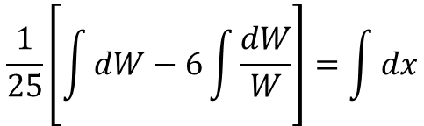
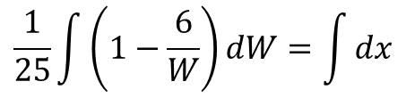
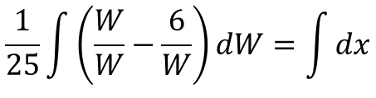
REDUCIBLES A VARIABLES SEPARABLES
$$\frac{1}{25}\int{\left(1−\frac{6}{W}\right)dW}=\int{dx}$$
$$\int{\frac{\frac{W−6}{5}}{W}\frac{dW}{5}}=\int{dx}$$
$$\frac{1}{25}\left[\int{dW−6\int{\frac{dW}{W}}}\right]=\int{dx}$$
$$\int{\frac{W−6}{5W}\frac{dW}{5}}=\int{dx}$$
$$\left[\int{dW−6\int{\frac{dW}{W}}}\right]=25\int{dx}$$
$$\frac{1}{25}\int{\left(\frac{W}{W}−\frac{6}{W}\right)dW}=\int{dx}$$

Slide 7

REDUCIBLES A VARIABLES SEPARABLES
$$W−6Ln\left(W\right)=C+25x$$
$$5(x+2y)+1−6Ln\left(5(x+2y)+1\right)=C+25x$$
$$5U+1−6Ln\left(5U+1\right)=C+25x$$
$$5x+10y+1−6Ln\left(5x+10y)+1\right)=C+25x$$
$$5x+10y−6Ln\left(5x+10y)+1\right)=C+25x$$

Slide 8





REDUCIBLES A VARIABLES SEPARABLES
Cambio de variable
Solucionar
$$U=2x+y$$
$$\frac{dy}{dx}=\frac{2x+y+1}{6x+3y−1}$$
$$\frac{dU}{dx}=2+\frac{dy}{dx}$$
Analizando la fracción observamos que en el denominador podemos factorizar el 3
$$\frac{dU}{dx}−2=\frac{dy}{dx}$$
$$\frac{dy}{dx}=\frac{(2x+y)+1}{3(2x+y)−1}$$

Slide 9





REDUCIBLES A VARIABLES SEPARABLES
Realizando la sustitución
$$\frac{dU}{dx}=\frac{U+1+2(3U−1)}{U−1}$$
$$\frac{dU}{dx}−2=\frac{U+1}{3U−1}$$
$$\frac{dU}{dx}=\frac{7U−1}{U−1}$$
Variables separables
despejando
Separando variables
$$\frac{dU}{dx}=\frac{U+1}{3U−1}+2$$
$$\frac{U−1}{7U−1}dU=dx$$

Slide 10
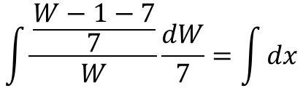

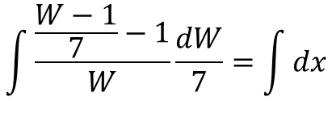
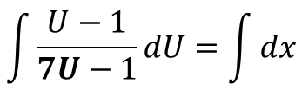



REDUCIBLES A VARIABLES SEPARABLES
Integrando
$$\frac{dU}{dx}=\frac{1}{7}\frac{dW}{dx}$$
$$\int{\frac{U−1}{7U−1}dU}=\int{dx}$$
Realizando la sustitución
Aplicando sustitución
$$\int{\frac{\frac{W−1}{7}−1}{W}\frac{dW}{7}}=\int{dx}$$
$$W=7U−1$$
$$W+1=7U$$
$$\int{\frac{\frac{W−1−7}{7}}{W}\frac{dW}{7}}=\int{dx}$$
$$U=\frac{W+1}{7}$$

Slide 11
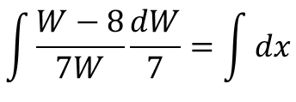
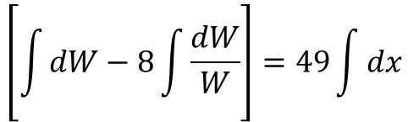
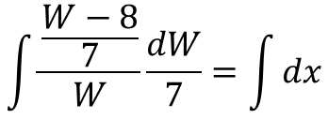
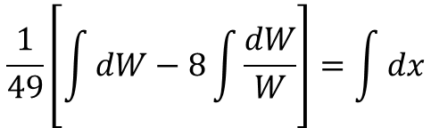
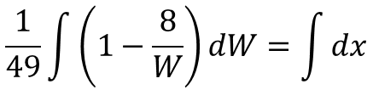
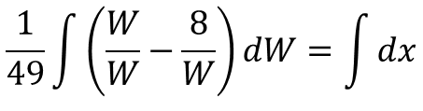
REDUCIBLES A VARIABLES SEPARABLES
$$\frac{1}{49}\int{\left(1−\frac{8}{W}\right)dW}=\int{dx}$$
$$\int{\frac{\frac{W−8}{7}}{W}\frac{dW}{7}}=\int{dx}$$
$$\frac{1}{49}\left[\int{dW−8\int{\frac{dW}{W}}}\right]=\int{dx}$$
$$\int{\frac{W−8}{7W}\frac{dW}{7}}=\int{dx}$$
$$\left[\int{dW−8\int{\frac{dW}{W}}}\right]=49\int{dx}$$
$$\frac{1}{49}\int{\left(\frac{W}{W}−\frac{8}{W}\right)dW}=\int{dx}$$

Slide 12

REDUCIBLES A VARIABLES SEPARABLES
$$W−8Ln\left(W\right)=C+49x$$
$$7U−1−8Ln\left(7U−1\right)=C+49x$$
$$7\left(2x+y\right)−1−8Ln\left(7\left(x+2y\right)−1\right)=C+49x$$
$$14x+7y−8Ln\left(14x+7y−1\right)=C+49x$$
$$14x+7y−1−8Ln\left(14x+7y−1\right)=C+49x$$

Slide 13


REDUCIBLES A VARIABLES SEPARABLES
Cambio de variable
Solucionar
$$U=2x+y$$
$$\frac{dy}{dx}=\frac{2x+y+1}{2x+y−1}$$
$$\frac{dU}{dx}=2+\frac{dy}{dx}$$
Analizando la fracción observamos que en el denominador y en denominador se encuentra la misma parte literal
$$\frac{dU}{dx}−2=\frac{dy}{dx}$$
$$\frac{dy}{dx}=\frac{2x+y+1}{2x+y−1}$$

Slide 14





REDUCIBLES A VARIABLES SEPARABLES
Realizando la sustitución
$$\frac{dU}{dx}=\frac{U+1+2(U−1)}{U−1}$$
$$\frac{dU}{dx}−2=\frac{U+1}{U−1}$$
$$\frac{dU}{dx}=\frac{3U−1}{U−1}$$
Variables separables
despejando
Separando variables
$$\frac{dU}{dx}=\frac{U+1}{U−1}+2$$
$$\frac{U−1}{3U−1}dU=dx$$

Slide 15
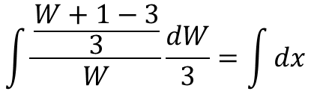

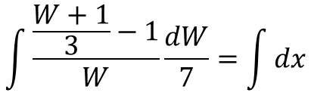
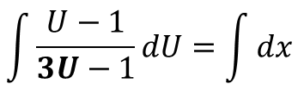



REDUCIBLES A VARIABLES SEPARABLES
Integrando
$$\frac{dU}{dx}=\frac{1}{3}\frac{dW}{dx}$$
$$\int{\frac{U−1}{3U−1}dU}=\int{dx}$$
Realizando la sustitución
Aplicando sustitución
$$\int{\frac{\frac{W+1}{3}−1}{W}\frac{dW}{7}}=\int{dx}$$
$$W=3U−1$$
$$W+1=3U$$
$$\int{\frac{\frac{W+1−3}{3}}{W}\frac{dW}{3}}=\int{dx}$$
$$U=\frac{W+1}{3}$$

Slide 16
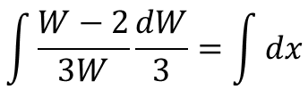
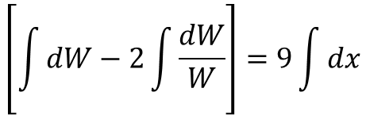
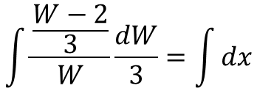
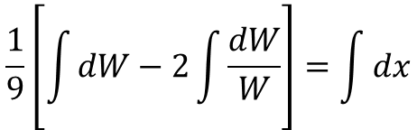
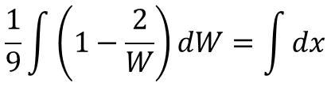
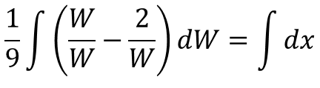
REDUCIBLES A VARIABLES SEPARABLES
$$\frac{1}{9}\int{\left(1−\frac{2}{W}\right)dW}=\int{dx}$$
$$\int{\frac{\frac{W−2}{3}}{W}\frac{dW}{3}}=\int{dx}$$
$$\frac{1}{9}\left[\int{dW−2\int{\frac{dW}{W}}}\right]=\int{dx}$$
$$\int{\frac{W−2}{3W}\frac{dW}{3}}=\int{dx}$$
$$\left[\int{dW−2\int{\frac{dW}{W}}}\right]=9\int{dx}$$
$$\frac{1}{9}\int{\left(\frac{W}{W}−\frac{2}{W}\right)dW}=\int{dx}$$

Slide 17

REDUCIBLES A VARIABLES SEPARABLES
$$W−2Ln\left(W\right)=C+9x$$
$$3U−1−2Ln\left(3U−1\right)=C+9x$$
$$3\left(2x+y\right)−1−2Ln\left(3\left(2x+y\right)−1\right)=C+9x$$
$$6x+3y−2Ln\left(6x+3y−1\right)=C+49x$$
$$6x+3y−1−2Ln\left(6x+3y−1\right)=C+9x$$

Slide 18
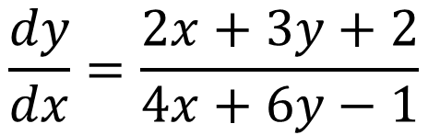
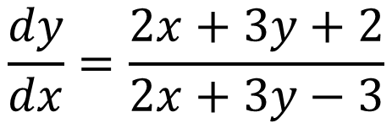
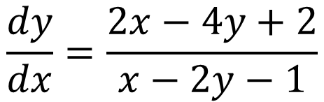
REDUCIBLES A VARIABLES SEPARABLES
ACTIVIDAD
$$\frac{dy}{dx}=\frac{2x+3y+2}{4x+6y−1}$$
Resolver las siguientes ecuaciones diferenciales
$$\frac{dy}{dx}=\frac{2x+3y+2}{2x+3y−3}$$
$$\frac{dy}{dx}=\frac{2x−4y+2}{x−2y−1}$$

Slide 19





REDUCIBLES A HOMOGENEAS
Planteamos el sistema lineal
En la Ecuaciones Diferenciales
$$a_{1}x+b_{1}y+c_{1}=0$$
$$\frac{dy}{dx}=f\left(\frac{a_{1}x+b_{1}y+c_{1}}{a_{2}x+b_{2}y+c_{2}}\right)$$
$$a_{2}x+b_{2}y+c_{2}=0$$
Lo cual es equivalente a
Si se tiene
$$a_{1}x+b_{1}y=−c_{1}$$
$$a_{2}x+b_{2}y+c_{2}≠k(a_{1}x+b_{1}y)+c_{1}$$
$$a_{2}x+b_{2}y=−c_{2}$$

Slide 20
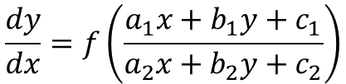






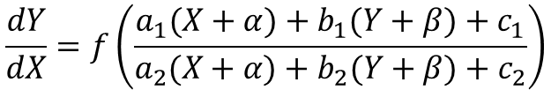
REDUCIBLES A HOMOGENEAS
$$dx=dX$$
El cual tiene como solución
$$dy=dY$$
$$x=α$$
$$y=β$$
Reemplazaos en la ecuación diferencial dada
Planteamos la sustitución
$$\frac{dy}{dx}=f\left(\frac{a_{1}x+b_{1}y+c_{1}}{a_{2}x+b_{2}y+c_{2}}\right)$$
$$x=X+β$$
$$y=Y+β$$
$$\frac{dY}{dX}=f\left(\frac{a_{1}(X+α)+b_{1}(Y+β)+c_{1}}{a_{2}(X+α)+b_{2}(Y+β)+c_{2}}\right)$$

Slide 21
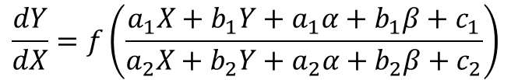
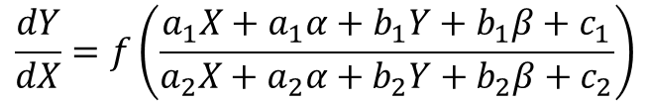
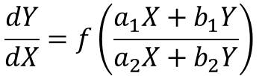
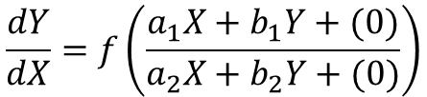
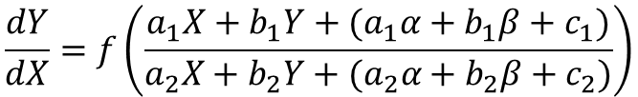
REDUCIBLES A HOMOGENEAS
$$\frac{dY}{dX}=f\left(\frac{a_{1}X+a_{1}α+b_{1}Y+b_{1}β+c_{1}}{a_{2}X+a_{2}α+b_{2}Y+b_{2}β+c_{2}}\right)$$
$$\frac{dY}{dX}=f\left(\frac{a_{1}X+b_{1}Y+(0)}{a_{2}X+b_{2}Y+(0)}\right)$$
$$\frac{dY}{dX}=f\left(\frac{a_{1}X+b_{1}Y+a_{1}α+b_{1}β+c_{1}}{a_{2}X+b_{2}Y+a_{2}α+b_{2}β+c_{2}}\right)$$
$$\frac{dY}{dX}=f\left(\frac{a_{1}X+b_{1}Y}{a_{2}X+b_{2}Y}\right)$$
ECUACION DIFERENCIAL HOMOGENEA
$$\frac{dY}{dX}=f\left(\frac{a_{1}X+b_{1}Y+(a_{1}α+b_{1}β+c_{1})}{a_{2}X+b_{2}Y+(a_{2}α+b_{2}β+c_{2})}\right)$$

Slide 22



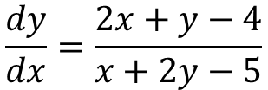



REDUCIBLES A HOMOGENEAS
$$\frac{dy}{dx}=\frac{2x+y−4}{x+2y−5}$$
Lo cual es equivalente a
$$2x+y=4$$
Planteamos el sistema lineal
$$x+2y=5$$
Cuya solución es
$$2x+y−4=0$$
$$x+2y−5=0$$
$$x=1$$
$$y=2$$

Slide 23
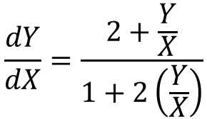

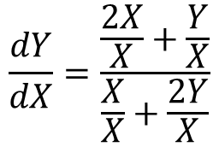






REDUCIBLES A HOMOGENEAS
Planteamos la sustitución
$$\frac{dY}{dX}=\frac{\frac{2X}{X}+\frac{Y}{X}}{\frac{X}{X}+\frac{2Y}{X}}$$
$$x=X+1$$
$$y=Y+2$$
$$dx=dX$$
$$dy=dY$$
$$\frac{dY}{dX}=\frac{2+\frac{Y}{X}}{1+2\left(\frac{Y}{X}\right)}$$
reemplazando
$$\frac{dY}{dX}=\frac{2X+Y}{X+2Y}$$
$$U=\frac{Y}{X}$$
Sea
Ecuación diferencial homogénea a resolver
$$\frac{dY}{dX}=U+X\frac{dU}{dX}$$

Slide 24

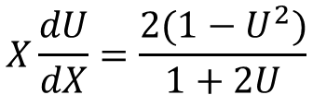

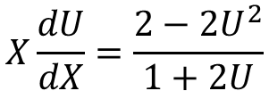
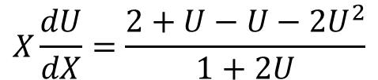

REDUCIBLES A HOMOGENEAS
Sustituyendo
$$X\frac{dU}{dX}=\frac{2+U−U−2U^{2}}{1+2U}$$
$$U+X\frac{dU}{dX}=\frac{2+U}{1+2U}$$
$$X\frac{dU}{dX}=\frac{2−2U^{2}}{1+2U}$$
$$X\frac{dU}{dX}=\frac{2+U}{1+2U}−U$$
$$X\frac{dU}{dX}=\frac{2(1−U^{2})}{1+2U}$$
$$X\frac{dU}{dX}=\frac{2+U−U(1+2U)}{1+2U}$$

Slide 25
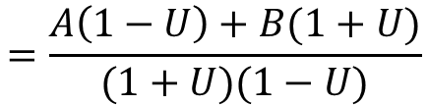
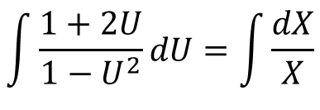


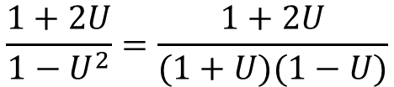


REDUCIBLES A HOMOGENEAS
$$\int{\frac{1+2U}{1−U^{2}}dU}$$
Fracciones Parciales
Separando variables
$$\frac{1+2U}{1−U^{2}}dU=\frac{dX}{X}$$
$$\frac{1+2U}{1−U^{2}}=\frac{1+2U}{(1+U)(1−U)}$$
$$\int{\frac{1+2U}{1−U^{2}}dU}=\int{\frac{dX}{X}}$$
$$=\frac{A}{1+U}+\frac{B}{1−U}$$
$$\int{\frac{1+2U}{1−U^{2}}dU}=C+LnX$$
$$=\frac{A\left(1−U\right)+B(1+U)}{(1+U)(1−U)}$$

Slide 26











REDUCIBLES A HOMOGENEAS
Igualando numeradores
$$−\frac{1}{2}∗\frac{1}{1+U}+\frac{3}{2}∗\frac{1}{1−U}$$
$$\frac{1+2U}{1−U^{2}}=$$
$$1+2U=A\left(1−U\right)+B(1+U)$$
Si $U= 1$
$$\int{\frac{1+2U}{1−U^{2}}dU}=$$
$$−\frac{1}{2}\int{\frac{dU}{1+U}}+\frac{3}{2}\int{\frac{dU}{1−U}}$$
$$3=2B de donde B=\frac{3}{2}$$
$$=−\frac{1}{2}Ln\left(1+U\right)−\frac{3}{2}Ln(1−U)$$
Si $U=−1$
$$−1=2A de donde A=−\frac{1}{2}$$
$$=−\left(Ln{\left(1+U\right)}^{\frac{1}{2}}+Ln{\left(1−U\right)}^{\frac{3}{2}}\right)$$

Slide 27








REDUCIBLES A HOMOGENEAS
$$\int{\frac{1+2U}{1−U^{2}}dU}=$$
$$−\left(Ln{(\left(1+U\right)}^{\frac{1}{2}}{\left(1−U\right)}^{\frac{3}{2}}) \right)$$
$${(\left(1+U\right)}^{\frac{1}{2}}{\left(1−U\right)}^{\frac{3}{2}})=CX$$
$$\int{\frac{1+2U}{1−U^{2}}dU}=C+LnX$$
$${\left(1+\frac{Y}{X}\right)}^{\frac{1}{2}}{\left(1−\frac{Y}{X}\right)}^{\frac{3}{2}}=CX$$
$$Ln{(\left(1+U\right)}^{\frac{1}{2}}{\left(1−U\right)}^{\frac{3}{2}})=C+LnX$$
$${\left(\frac{X+Y}{X}\right)}^{\frac{1}{2}}{\left(\frac{X−Y}{X}\right)}^{\frac{3}{2}}=CX$$
$$Ln{(\left(1+U\right)}^{\frac{1}{2}}{\left(1−U\right)}^{\frac{3}{2}})=LnC+LnX$$

Slide 28




REDUCIBLES A HOMOGENEAS
$$\frac{{\left(X+Y\right)}^{\frac{1}{2}}}{X^{1/2}}\frac{{\left(X−Y\right)}^{\frac{3}{2}}}{X^{3/2}}=CX$$
$${\left(x−1+y−2\right)}^{\frac{1}{2}}{\left(x−1−y+2\right)}^{\frac{3}{2}}=C{\left(x−1\right)}^{3}$$
$$\frac{{\left(X+Y\right)}^{\frac{1}{2}}}{X^{2}}\frac{{\left(X−Y\right)}^{\frac{3}{2}}}{}=CX$$
$${\left(x+y−3\right)}^{\frac{1}{2}}{\left(x−y+1\right)}^{\frac{3}{2}}=C{\left(x−1\right)}^{3}$$
$${\left(X+Y\right)}^{\frac{1}{2}}{\left(X−Y\right)}^{\frac{3}{2}}=CX^{3}$$

Slide 29



REDUCIBLES A HOMOGENEAS
$$\frac{dy}{dx}=\frac{x+y−4}{x+2y−6}$$
$$\frac{dy}{dx}=\frac{2x+y+4}{x−y+5}$$
$$\frac{dy}{dx}=\frac{2x+3y−5}{x+y−2}$$

Slide 30


